Slide 1
Financial data analysis

Slide 2
PROBLEM STATEMENT
The problem statement for this project involves analyzing the competition within the top 500 companies in India based on their market capitalization. The goal is to derive insights that can help the management understand the competitive landscape and make informed decisions to improve business results. This involves examining various financial metrics and uncovering meaningful relationships between different attributes provided in the dataset.

Slide 3
OBJECTIVE
The primary objective of this project is to conduct a thorough analysis of the top 500 companies in India to identify key metrics and factors that influence their market capitalization. By doing this, the project aims to:
Identify Key Metrics
Explore meaningful relationships between attributes such as market capitalization, quarterly sales, and other relevant financial metrics.
Visualized the largest & smallest companies based on market cap & quarterly sales

Slide 4
DATA PREPROCESSING
Renaming the columns
df.columns = ['S.NO','Company Name','Market_cap','Qtr_sales','Unnamed’]
Getting the qtr sales column missed values from the unnamed column
for i in range(len(df)):
if pd.isnull(df['Unnamed'][i]):
pass
else:
df.loc[i,'Qtr_sales']=df['Unnamed'][i]

Slide 5
Removing the Unwanted Features
Treating the null values with median values
market Cap Skewness: 5.560197674089212
qtr_sales_skew: 6.833822665838169
USING THE FUNCTION:
REMOVE THE SPACE FROM DATA
for i in range(len(df)):
if df['Company Name'][i].isupper():
df.loc[i,'Company Name']= df['Company Name'][i].replace(' ',‘’)

Slide 6
VISUALISATION ANALYSIS
Largest Market Cap company:
Company Name Market_cap
Reliance Inds. 583436.72
Smallest Market Cap company:
Company Name Market_cap
Natl.Fertilizer 3017.07
Largest Qtr sales company:
Company Name Qtr_sales
IOCL 110666.93
Smallest Qtr sales company:
Company Name Qtr_sales
Ujjivan Fin.Ser. 0.0

Slide 7
OBSERVATIONS
TOP 10 LARGEST P/S RATIO COMPANY
Company Name Price_sales_ratio
Ujjivan Fin.Ser. Inf
Sparc 553.82
Bajaj Holdings 95.35
Tata Inv.Corpn. 93.61
Indian Energy Ex 70.98
Central Dep. Ser 70.20
Forbes & Co 67.76
Multi Comm. Exc. 63.10
Delta Corp 58.78
ERIS Lifescience 56.47
TOP 10 SMALLEST P/S RATIO COMPANY
Company Name Price_sales_ratio
Redington India 0.50
Rajesh Exports 0.57
CPCL 0.63
Corporation Bank 0.85
Oriental Bank 0.86
Andhra Bank 0.89
Allahabad Bank 0.97
HPCL 1.01
Natl.Fertilizer 1.06
Syndicate Bank 1.13

Slide 8
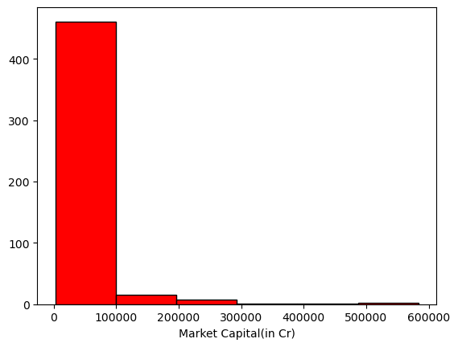
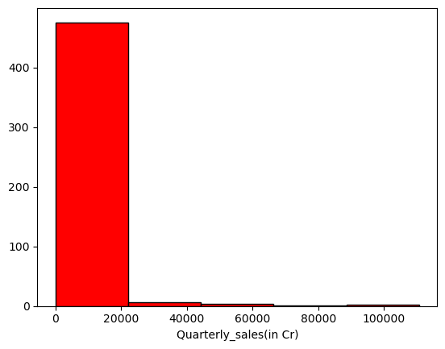
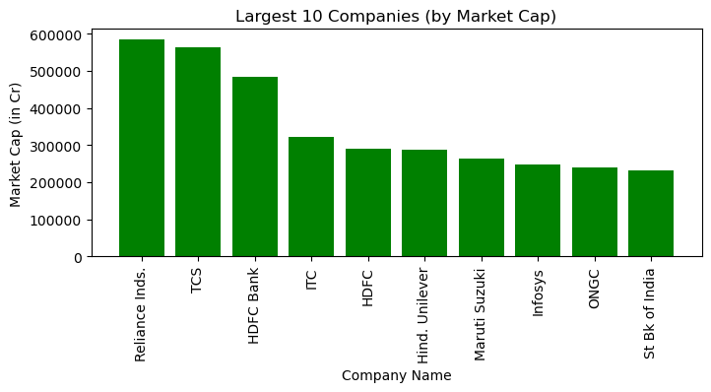
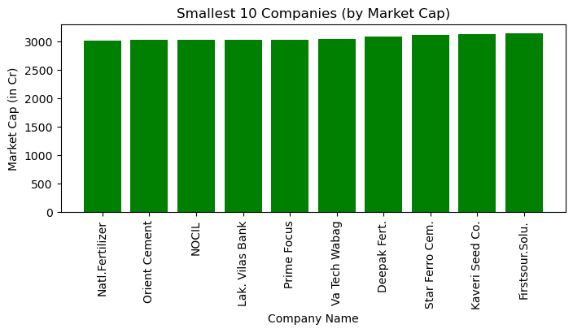

Slide 9
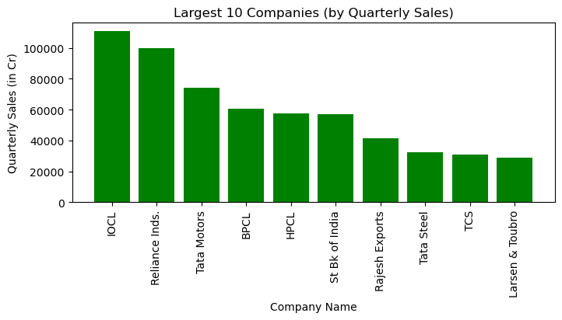
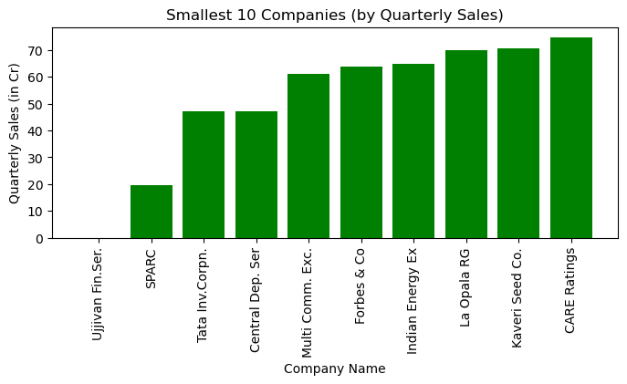
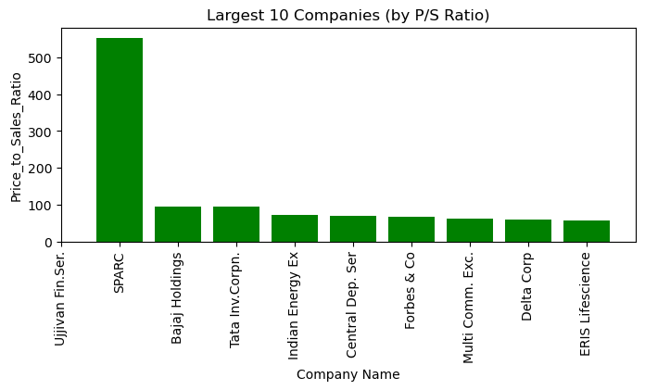
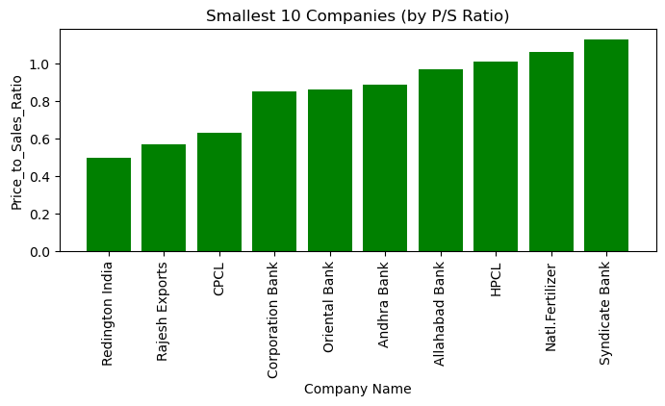

Slide 10
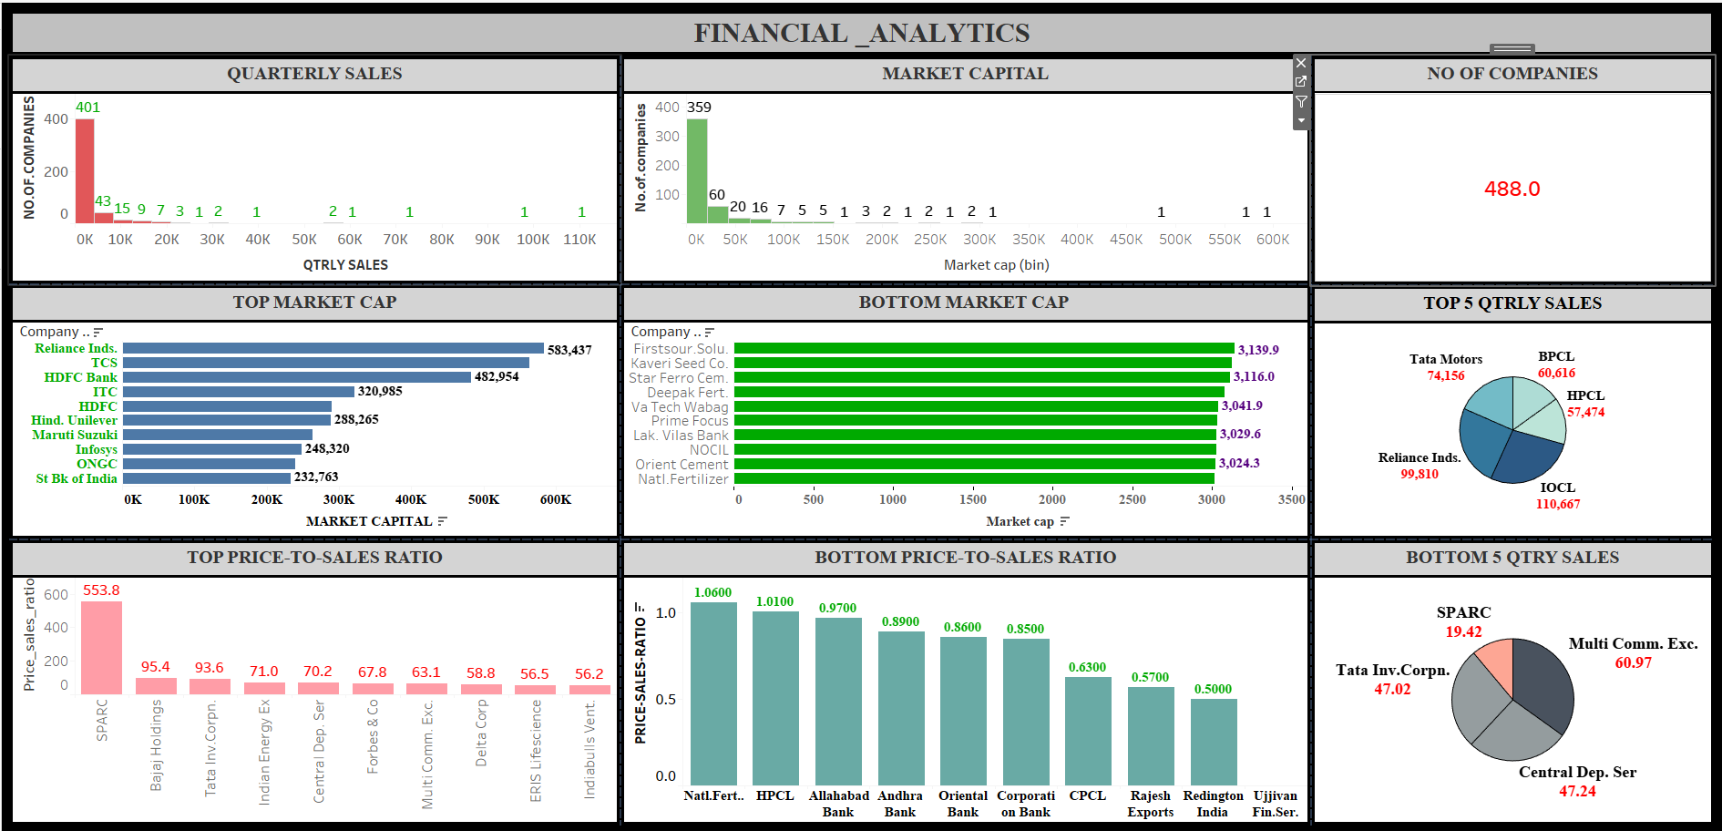
TABLEAU DASHBOARD

Slide 11



Thank you
KABILAN G
g.kabilan227@gmail.com

